Slide 1
Network Science for Healthcare Research
April 18, 2018
Vicki Stover Hertzberg, PhD

Slide 2
Q: What do the following have in common?
The ancient Greek world
Hamlet
Scientific citations
An STD epidemic in Manitoba
Finding a job
Cattle movements in Great Britain
The nervous system of the nematode
Professional tennis

Slide 3
A:
All have benefitted by the application of the tools of network science to gain unique insights into their nature.

Slide 4
Example - 1
Source: Delta Airlines

Slide 5
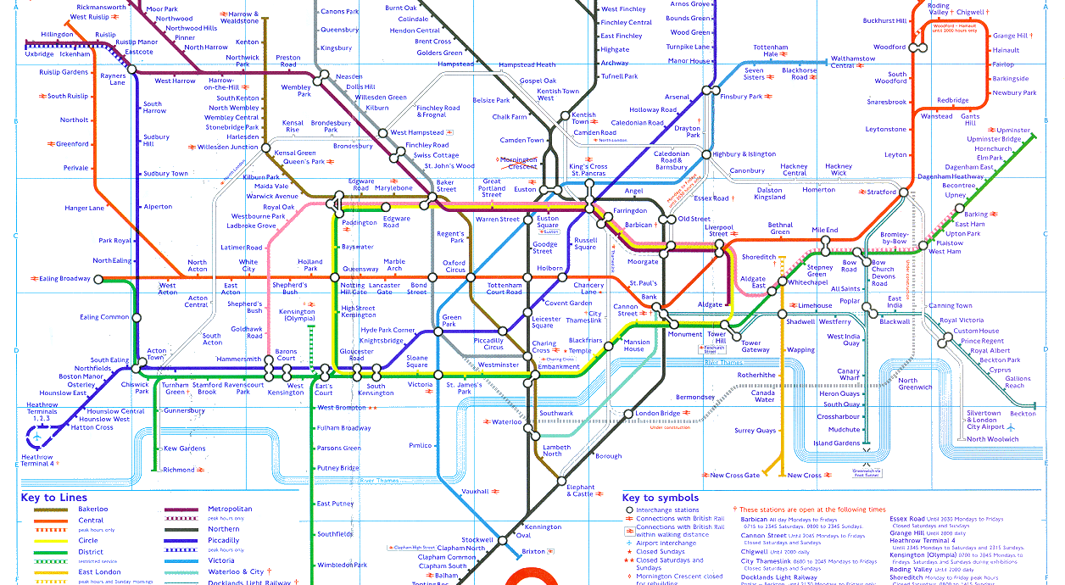
Example - 2
Source: London Underground

Slide 6
Example 3: Ancient Greek World
Source: Amazon.com

Slide 7
Example 4: Hamlet

Slide 8
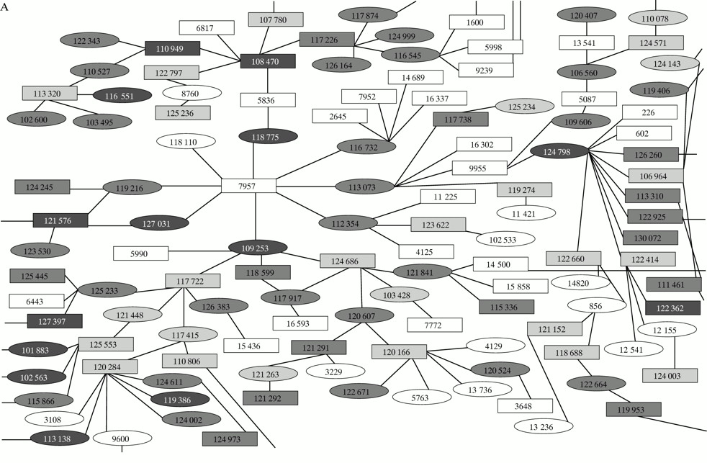
Example 5: STD Epidemic in Manitoba
(A) Section of the large network showing 126 individuals, the upper limits of which were never established.
Jolly A M , Wylie J L Sex Trans Infect 2002;78:i145-i151
©2002 by BMJ Publishing Group Ltd
Notes:
(A) Section of the large network showing 126 individuals, the upper limits of which were never established. Contacts who never had laboratory confirmed infection are shown in clear white; gonorrhea cases in pale grey; chlamydia in mid-grey; and co-infected individuals in dark grey. Male subjects are depicted by rectangles; female subjects by ellipses, and each node contains the individual's study identifier. (B) Section of large network of people (n = 126) with chlamydia and/or gonorrhea, the upper limits of which were never established, Manitoba 1990–92. Contacts who were never confirmed cases are shown in clear white; cases testing positive once are shown in orange, and those testing positive twice or more are shown in red. Male subjects are depicted by rectangles; female subjects by ellipses, each of which contain study identification numbers.

Slide 9
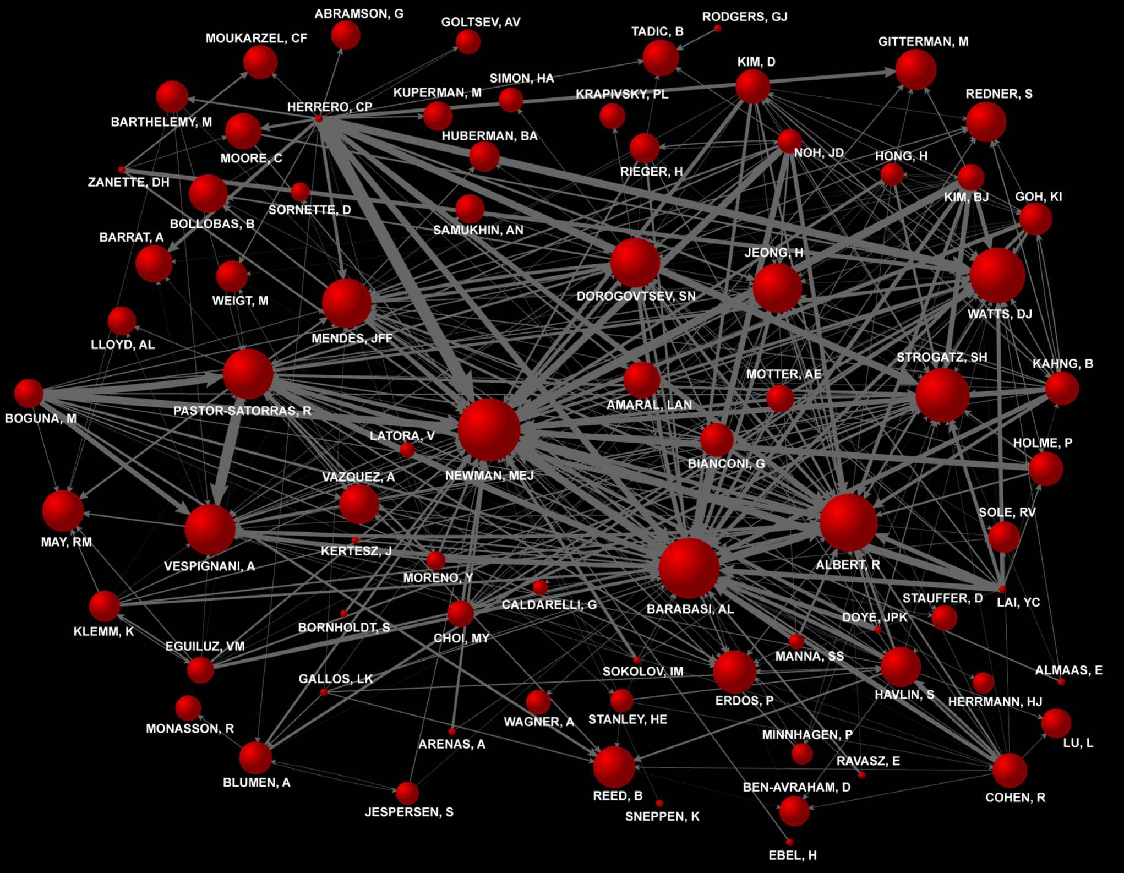
Example 6: Scientific Citations

Slide 10
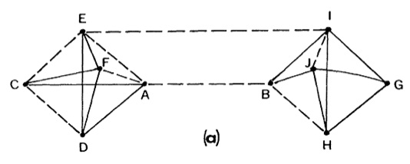
Example 7: Finding a job
From: Gronovetter, 2003; Am J Soc
Source: jordi.pro/netbiz

Slide 11
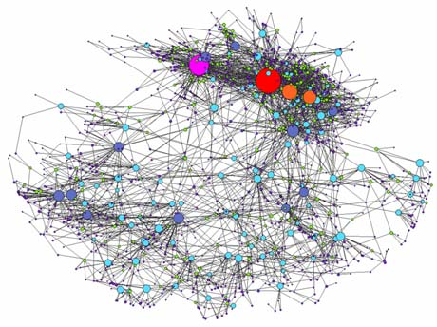
Example 8: UK Cattle Movement
Source: http://www.liv.ac.uk/researchintelligence/issue39/datamining.htm

Slide 12
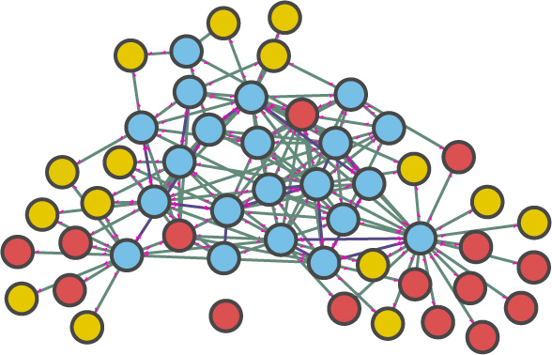
Example 9: Nematode Nervous System
Source: http://acrobeles.wordpress.com/2010/06/21/pristionchus-pharynx-connectome/
Notes:
network graph showing all of the synaptic connections in the pharynx of the nematode Prisitonchus pacificus.

Slide 13
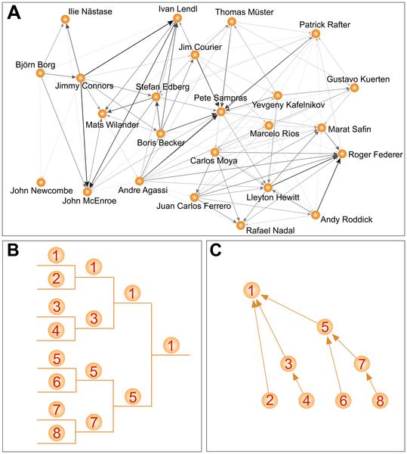
Example 10: Professional Tennis
Source: Radicchi, PLoSone, 2011

Slide 14
Example 11
Souurce: visualcomplexity.com

Slide 15
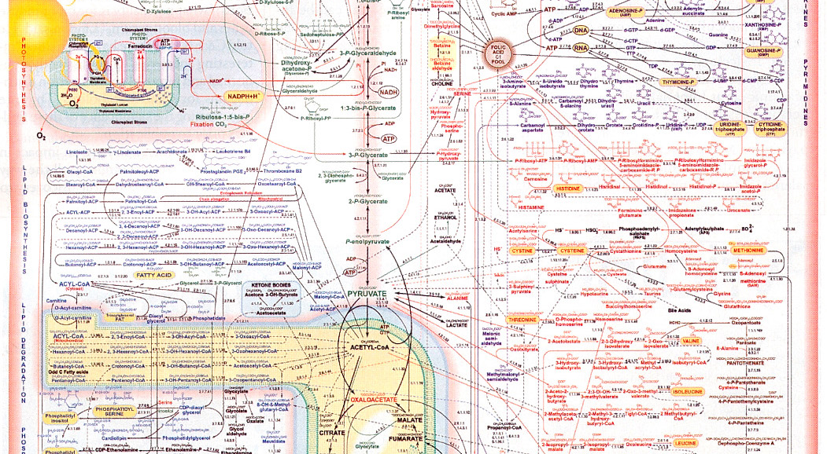
Example 12
Source: Sigma Chemical Company

Slide 16
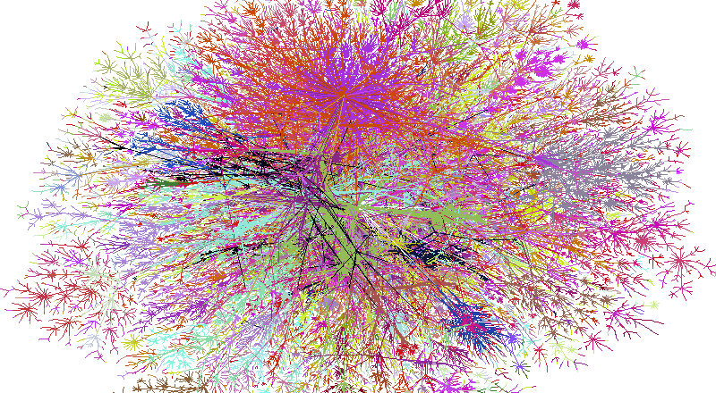
Example 13
Source: Lumeta Corp.

Slide 17
Example 14
Jake Hofman, Yahoo Research

Slide 18
Example 15
18th century letters

Slide 19
Why model networks?
Insight into structure (model)
Erdos-Renyi-Gilbert random graph
Watts-Strogatz small world model
Barabasi-Albert scale-free model
Understanding implications (dynamics)
Diffusion (information, disease)
Search
Resilience

Slide 20
What are networks?
Networks are collections of points joined by lines

Slide 21
Different Languages of Networks
Discipline | Points | Lines
Mathematics | vertices | edges, arcs
Computer Science | nodes | links
Physics | sites | bonds
Sociology | actors | ties, relations

Slide 22
Brief History
Leonhard Euler (1707 – 1783)
Swiss mathematician and physicist
Konigsburg bridge problem (1736)
Source: Wikipedia

Slide 23
Brief History
Paul Erdos (1913 – 1996)
Hungarian mathematician
Random graphs
Source: Wikipedia

Slide 24
Brief History
Milgram 1967
Picked 300 people at random from Nebraska
Asked them to get a letter to a stockbroker in Boston – they could pass the letter on only through friends they knew on a first-name basis
How many steps did it take?
Six Degrees of Separation (play by John Guare)

Slide 25
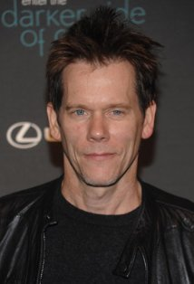
Brief History
Kevin Bacon (1996)
Kevin Bacon is the Center of the Universe (1996)
Oracle of Kevin Bacon (1999)
UVA CS grad students
IMDB
What is Elvis Presley’s Bacon number?
Photo credit: IMDB
Notes:
Elvis was in Change of Habit (1969) with Ed Asner.
Ed Asner was in JFK (1991) with Kevin Bacon.

Slide 26
Problem
Most real world networks did not behave like Erdos’ random graphs!

Slide 27
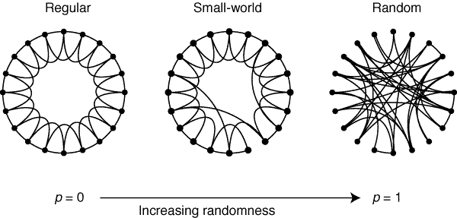
1998: In Mathematics
Watts and Strogatz
Interested in biological synchronicity
Found small worlds created by randomly rewiring ring lattices

Slide 28
Brief History

Slide 29
Brief History
Enter the physicists
Percolation

Slide 30
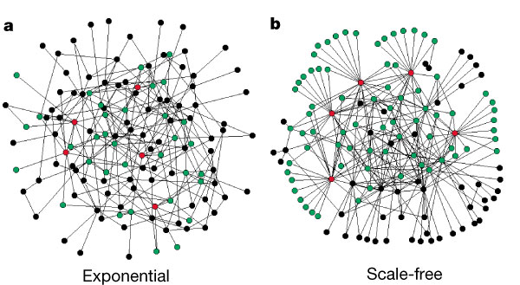
1999: In Physics
Albert and Barabasi
Interested in the size of the internet
Found a preferential attachment model for network growth

Slide 31
All this math stuff is nice…
…but what about social networks?

Slide 32
Reasons for recent growth
Social scientists disillusioned with attribute theories of behavior (i.e., do not help to explain how to change behaviors)
Many current social activities are inherently network activities
Improvements in computation and graphical display
Gain in-depth understanding of how behaviors are distributed in networks and factors associated with behavior change.

Slide 33
Key Insights
Connections are not random
Patterns of connections can be reduced to a set of functionally equivalent positions

Slide 34
Diffusion of Innovations
Adoption of a new idea, practice, or object

Slide 35
Four Elements of Influence
Innovation
Communication channels
Time
Social system

Slide 36
Backlash
Diffusion theory recognized in the adoption of innovations of practices with negative impacts
Diffusion theory became synonymous with cultural imperialism

Slide 37
Resurgence of Interest
Resurgence of interest in social networks about 15 years ago due to
Seminal findings of
Watts and Strogatz
Barabasi and Albert
“Ease” of computing

Slide 38
Key Point
A graph is an object
A network brings that object to life
Two big concerns
How are nodes connected by edges?
To what extent does any node dominate?
Local influence
Control of “traffic”
Ability to reach any other node through it

Slide 39
Use networks to address questions like:
How does density influence diffusion?
What is the most efficient structure for reaching group goals?
If optimal structures exist, can we create them?
Can we “vaccinate” a given network to prevent spread or to prevent break-down?

Slide 40
How would you go about doing a (network) study?

Slide 41
Steps
Literature review
Formulate hypothesis
Decide on population and boundaries (**)
Gather data (**)
Assemble data (*)
Analysis and visualization (***)
Further interpretation

Slide 42
Analyzing Networks
Data needs
A list of nodes (actors)
A list of edges (relationships)
Software
Gephi
R packages
igraph
statnet

Slide 43
Example
movements on a plane

Slide 44
Want more?
INFO 544: Network Science for Public Health
NRSG 540: Network Science for Nursing Research
Fall 2017, part 1
MW 1-2:50 pm

Slide 45
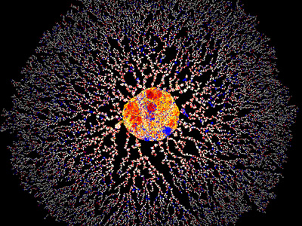
What questions do you have?
Image source: http://bioinformatics.icmb.utexas.edu/lgl/#gallery

